Slide 1
The use of gene-based functional exome scans for compound heterozygosity with application to hemochromatosis
Shicheng Guo
Steven Schrodi
……..
2018/01/18
Nature Genetics (Letters / Technical Reports)

Slide 2
Result 1: Statistic part
Compound hetrogygosity scanning for hemochromatosis susceptibility genes
1, Power calculation
2, Significant novel susceptibility genes
FGF6
FGFR10P
MTAP
Meanwhile, mention FGF26 has been reported by PNAS.
3, Haplotype association details
most frequent haplotype
Table 1

Slide 3
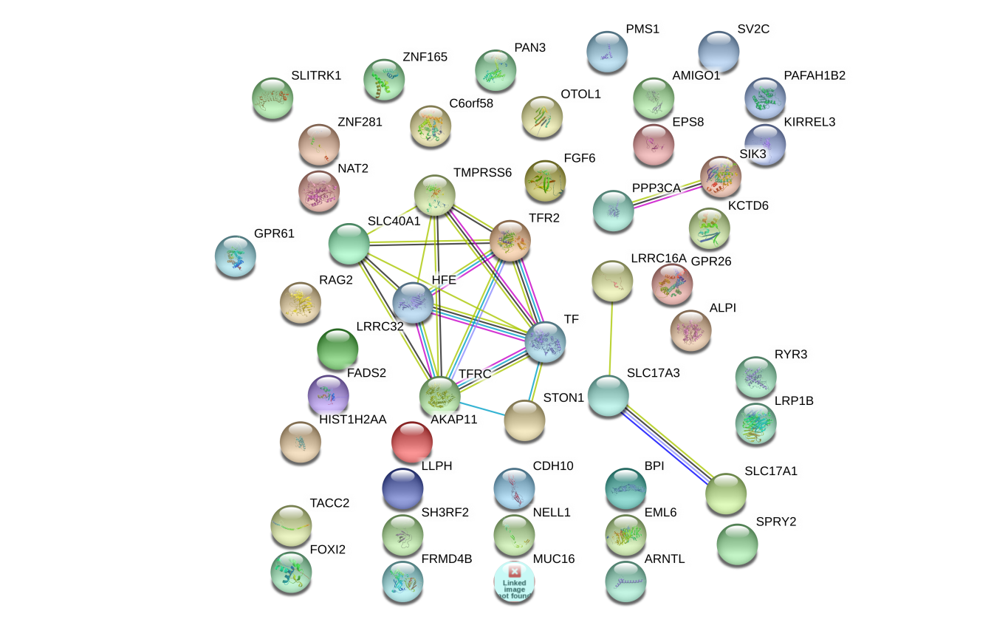
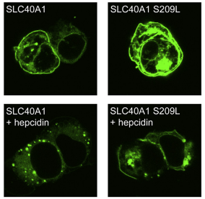
Result 2: In vitro cell study
FGF6 and FGF23: Biology Function in iron metabolism pathway
iron metabolism gene transcriptome network turbulence (regulator)
iron metabolism protein cell locating turbulence (Carrier)
Hemoglobin (HBA1, HBA2, and HBB)
Ferritin (FTH1)
Lactoferrin (LT/LFT)
transferrin (TF)
FGF6
FGF23
PPP3CA
SIK3
LRRC16A
SLC17A3
SLC17A1
TF
FPN
CDH10
SLC40A1
HFE
TMPRSS6
TFR2
STON1
Iron-binding proteins are carrier proteins and metalloproteins which play many important roles in metabolism. Iron is required by humans and bacteria for enzymes and metabolism to function properly. Iron-binding proteins bind iron tightly which make it unavailable for microbial use, limiting growth. Four iron-binding proteins are Hemoglobin, Ferritin, lactoferrin and transferrin. Hemoglobin is located in red blood cells. Transferrin is found in blood and tissue fluids. Lactoferrin is found in milk, blood, tears and saliva. Ferritin is found in every cell type.
https://string-db.org/
KEGG pathway(?)
Another interaction network method.
Figure 1. (a): Network
Figure 1. (b): location

Slide 4
FGF6 pathway interacted with Iron metabolism pathway
Known FGF6 pathway in KEGG
 | KEGG - Kyoto Encyclopedia of Genes and Genomes hsa04010 - MAPK signaling pathway hsa04810 - Regulation of actin cytoskeleton hsa05200 - Pathways in cancer hsa05218 - Melanoma
Known Iron metabolism pathway in KEGG
(Reactome and KEGG)
NCOA4
CUL1 HMOX1 SKP1
Iron metabolism
hsa05200 - Pathways in cancer

Slide 5
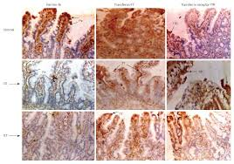
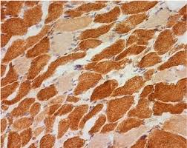
Result 3: FGF6 Gene knock-out mice model
Liver
Muscle
Figure 3: immunohistochemistry to show Iron quantification in different tissues
Answer the question:
FGF6 most significantly play iron overload roles in muscle or liver or both?

Slide 6
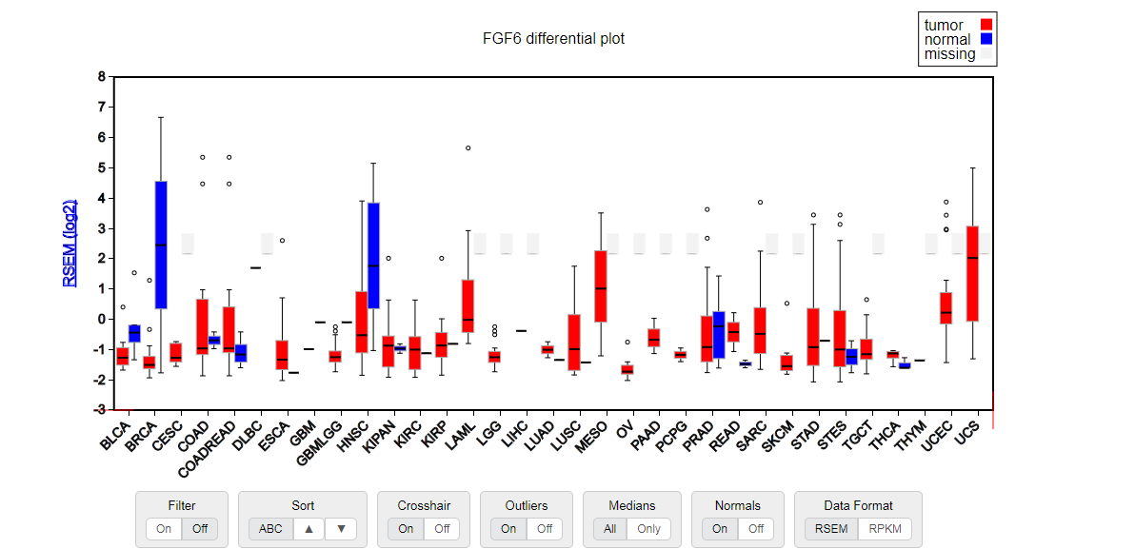
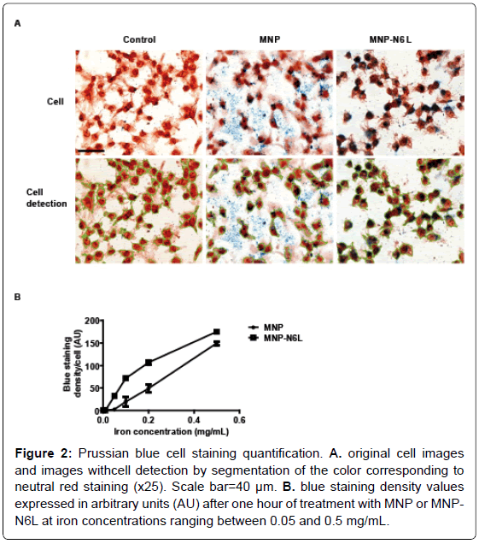
Result 4: FGF6 depression and cancer iron metabolism
FGF6 depression and cancer cellular nutrient
Immunohistochemistry for FGF6 and Iron at same time in Breast cancer and adjacent normal breast
Functional validation assays show that apparently FGF6 act as tumor suppressors in vivo. systemic administration might restore tumor suppressor function and serve as new biological anticancer therapies. J Hepatol. 2010 Jun; 52(6): 921–929.
Fe is an essential cellular nutrient that is critical for DNA synthesis and therefore cancer need more Fe
We found FGF6 is down-regulated (Loss-of-Function) in the majority cancer types which data is available.

Slide 7
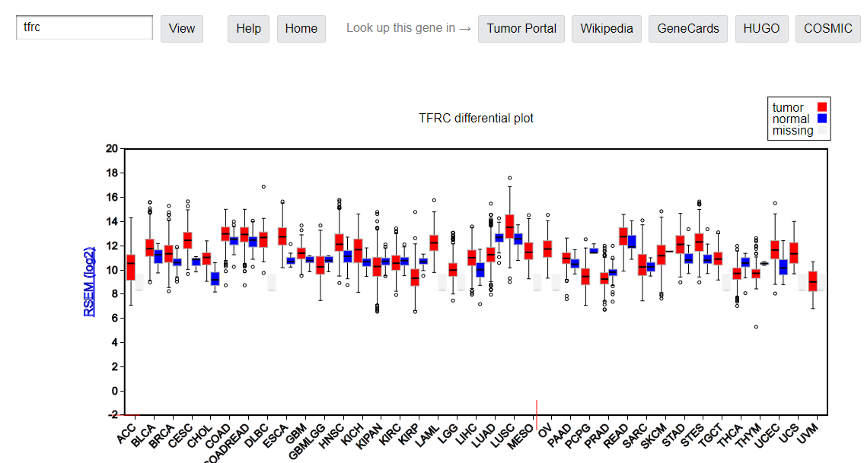
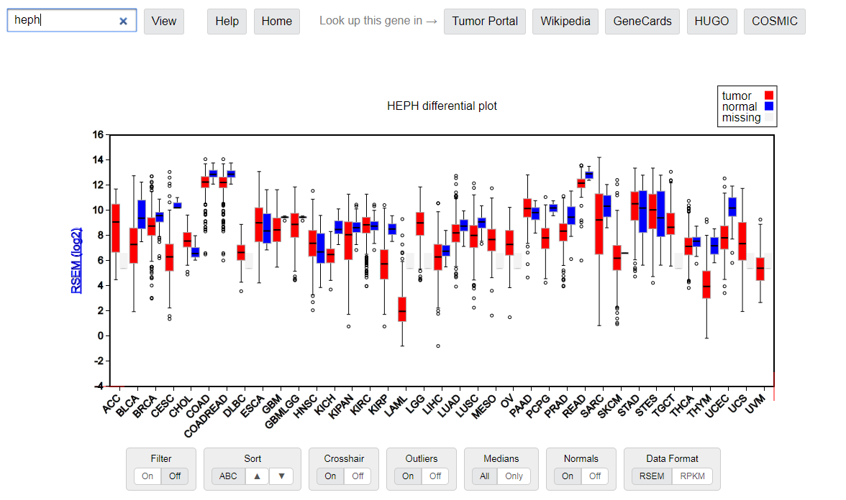
TFRC and HEPH in cancer tissues
TFRC is iron input protein and it was upregulated in cancer tissues suggesting cancer need more Iron in its progressive
HEPH is iron output protein and it was down-regulated in cancer tissues suggesting cancer need keep more irons for its proliferation.

Slide 8
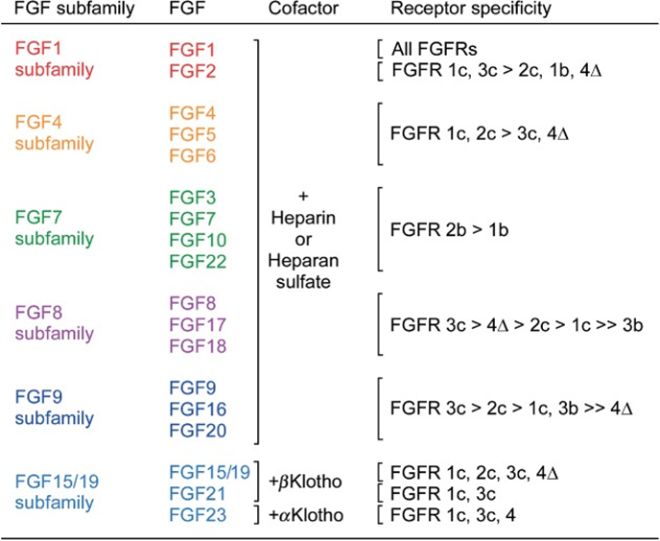
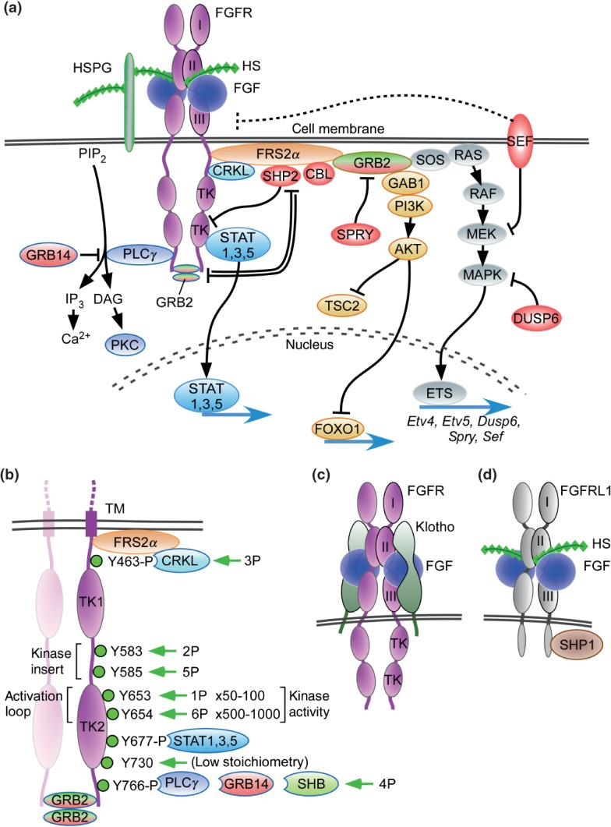
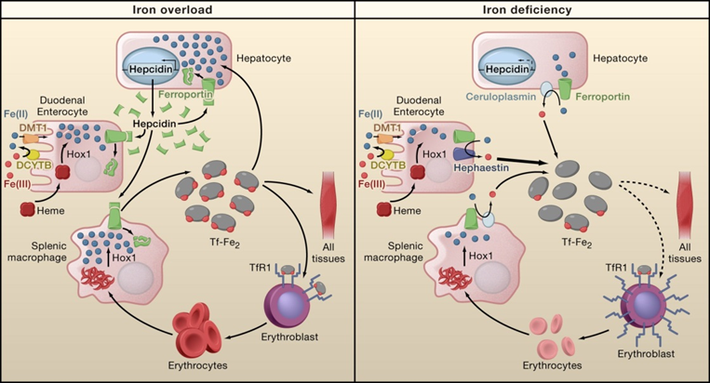
FGF6 and Iron Metabolism Interaction
Heparin: a potent inhibitor of hepcidin expression in vitro and in vivo (BLOOD, 2011 VOLUME 117, NUMBER 3 997 )
Notes:
Wiley Interdisciplinary Reviews. Developmental Biology
PMC full text:Wiley Interdiscip Rev Dev Biol. 2015 May; 4(3): 215–266.
Published online 2015 Mar 13. doi: 10.1002/wdev.176
Copyright/License ►Request permission to reuse
<< PrevFigure 3Next >>
Figure 3
FGF signaling pathways. (a) Binding of canonical FGFs to FGFR with HS (or HSPG) as a cofactor induces the formation of ternary FGF-FGFR-HS complex, which activates the FGFR intracellular tyrosine kinase domain by phosphorylation of specific tyrosine residues. The activated receptor is coupled to intracellular signaling pathways including the RAS-MAPK, PI3K-AKT, PLCγ, and STAT pathways. The RAS-MAPK pathway: The major FGFR kinase substrate, FRS2α, which is constitutively associated with the juxtamembrane region of FGFR (peptide: MAVHKLAKSIPLRRQVTVSADS), interacts with CRKL bound to pY463 and is phosphorylated by the activated FGFR kinase. Phosphorylated FRS2α recruits the adaptor protein GRB2, which then recruits the guanine nucleotide exchange factor SOS. The recruited SOS activates the RAS GTPase, which then activates the MAPK pathway. MAPK activates members of the Ets transcription factor family such as Etv4 (Pea3) and Etv5 (Erm) and negative regulators of the FGF signaling pathways such as SHP2, CBL, SPRY, SEF, and DUSP6. The PI3-AKT pathway: The recruited GRB2 also recruits the adaptor protein GAB1, which then activates the enzyme PI3K, which then phosphorylates the enzyme AKT. AKT has multiple activities including activation of the mTOR complex 1 through inhibition of TSC2 and phosphorylation of the FOXO1 transcription factor causing it to exit the nucleus. The PLCγ pathway: Activated FGFR kinase recruits and activates the enzyme PLCγ, which produces IP₃ and DAG by the hydrolysis of PIP₂. IP₃ induces calcium ion release from intracellular stores and the activation of downstream signaling pathways. DAG activates the enzyme PKC and its downstream signaling pathways. GRB14 inhibits activation of PLCγ. The STAT pathway: FGFR kinase also activates STAT1, 3, and 5. STAT3 interacts with phosphorylated tyrosine 677 (pYxxQ motif). These activated signaling pathways mostly regulate gene expression in the nucleus. SPRY interacts with GRB2 to inhibit the RAS-MAPK pathway and to regulate the PI3K-AKT pathway. GRB2 dimers are docked at the c-terminus of FGFR2 where they inhibit SHP2, allowing low-level receptor kinase activity. Molecules shaded red generally function to inhibit FGFR signaling. (b) Dimerization of the FGFR1 kinase domain leads to sequential phosphorylation of tyrosine residues (1P–6P) leading to increasing activity of the FGFR kinase and phosphorylation of tyrosine substrates for CRKL, STAT, GRB14, and PLCγ binding. In the first phase of activation, Y653 (1P), in the activation loop, is phosphorylated, resulting in a 50- to 100-fold increase in kinase activity. In the third phase of activation, Y654 (6P), in the activation loop, is phosphorylated, resulting in an overall 500–1000 fold increase in kinase activity. Y730 is weakly phosphorylated. Phosphorylation of Y677 allows docking of STAT3 and phosphorylation of Y766 allows docking of either GRB14 or PLCγ. Ligand-induced receptor activation phosphorylates GRB2, leading to its dissociation from the receptor. Tyrosine residues correspond to human FGFR1 (accession NP_075598). (c) Binding of endocrine FGF to FGFR with Klotho as a cofactor induces the formation of ternary FGF-FGFR-Klotho complex, which leads to activation of the FGFR tyrosine kinase. (d) FGFRL1 is a protein containing three extracellular immunoglobulin-like domains with similarity to FGFRs. FGFRL1 has a single transmembrane domain, and a short intracellular tail with no tyrosine kinase domain. The short cytoplasmic domain contains an SH2 binding motif that interacts with SHP1. FGFRL1 is not simply a decoy receptor, but rather a non-tyrosine kinase signaling molecule.
Images in this article
Click on the image to see a larger version.

Slide 9
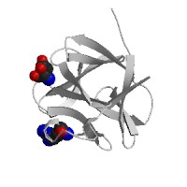
FGF6 protein structure simulation, Heparin and hepcidin
1, different SNPs
2, different combining ability

Slide 10
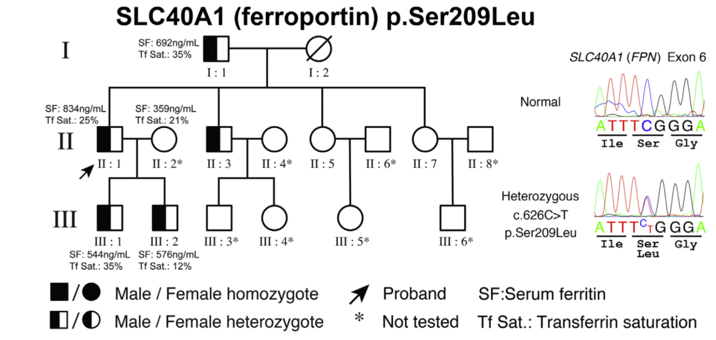
IID | Name | Seq sample ID | Age
I：1 | 姜殿才 | 1 | 76
II：1 | 姜素国 | 2 | 48
II：3 | 姜树林 | 3 | 45
II：5 | 姜张英 | 4 | 43
II：7 | 姜二英 | 5 | 40
III：1 | 姜金波 | 6 | 27
III：2 | 姜金涛 | 7 | 23

Slide 11
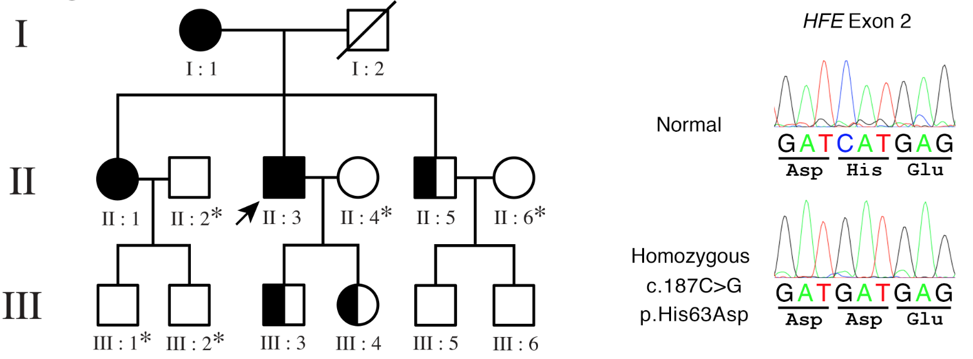
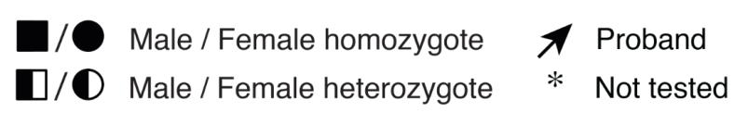
IID | Name | Seq sample ID | Age
I：1 | A2赵母 | 2 | 79
I：2 | 赵父（63岁去世）
II：1 | A7赵姐 | 7 | 43
II：3 | A1赵患（先证者） | 1 | 40
II：5 | A8赵弟 | 8 | 35
III：3 | A3赵银松（儿子） | 3 | 14
III：4 | 赵璐璐（女儿） | 5 | 2
III：5 | A4赵子威 （侄子） | 4 | 10
III：6 | 赵陈陈 （侄子） | 6 | 4

Slide 12
Conclusion
1, We proposed a new compound heterozygosity method to identify loss-of-function variants
2, We identify new FGF6 causal genes for hemochromatosis

Slide 13
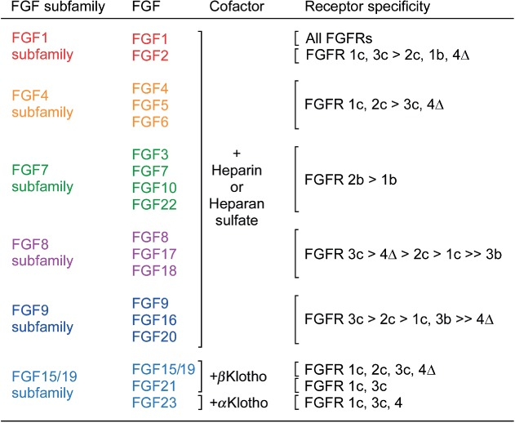
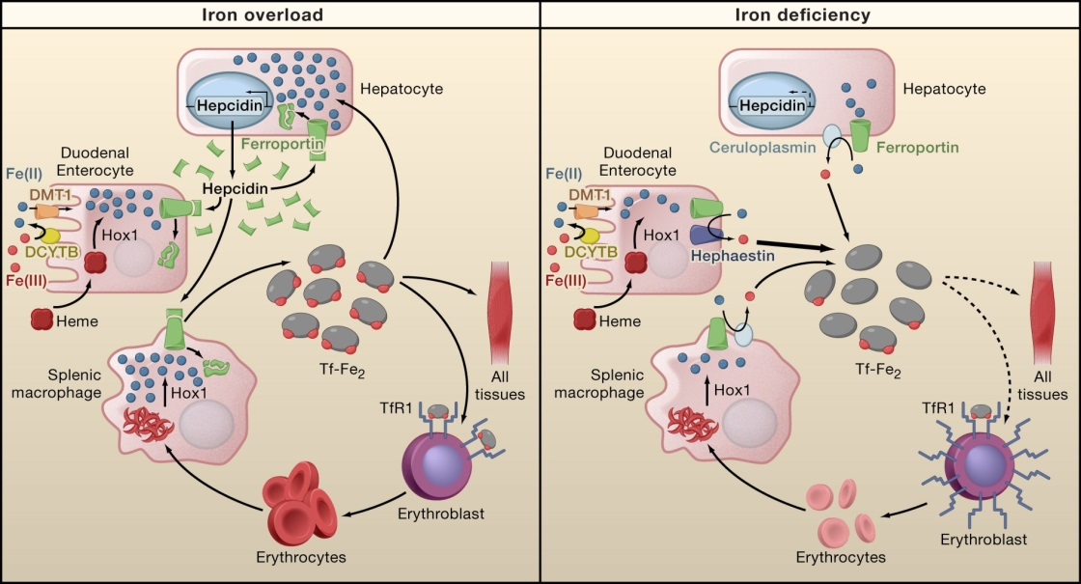
Heparin: a potent inhibitor of hepcidin expression in vitro and in vivo (BLOOD, 20 JANUARY 2011 VOLUME 117, NUMBER 3 997 )
Notes:
Receptor specificity of canonical and endocrine FGFs. The six subfamilies of signaling FGFs use either heparin-like molecules or Klotho molecules as cofactors for receptor binding. Data is derived from receptor activation assays using BaF3 cells, L6 myoblasts, or HEK293 cells transfected with individual splice variants of FGFRs or by direct binding studies.^{140,141,162,237,238,246–254} FGFR4Δ is a two immunoglobulin-like domain form of FGFR4.

Slide 14
Other question:
The common C282Y mutation of the HFE gene is not found in Chinese Why?
Evolution view/role of FGF6 and any interesting story with this study.
Evolution: Fibroblast growth factors: from molecular evolution to roles in development, metabolism and disease

Slide 15
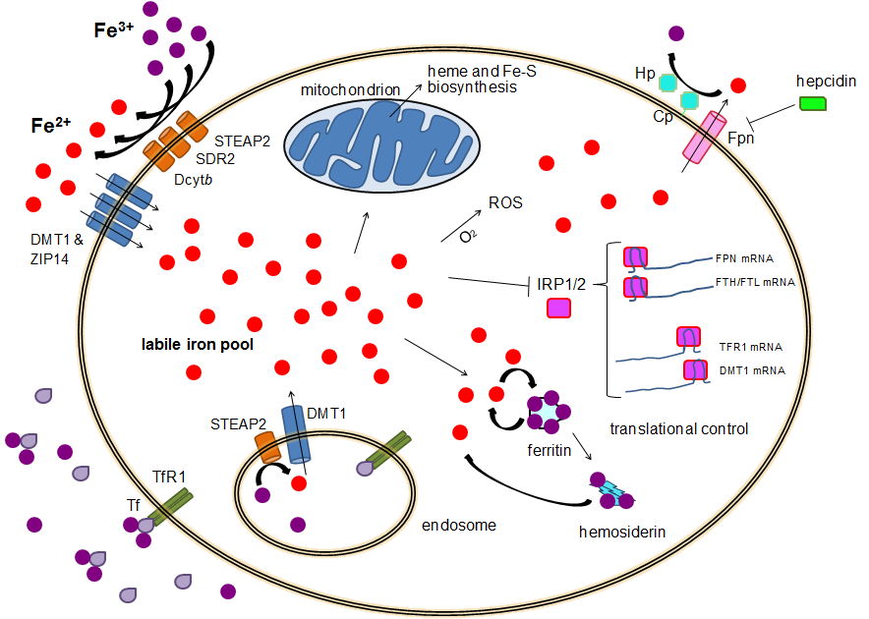

Slide 16
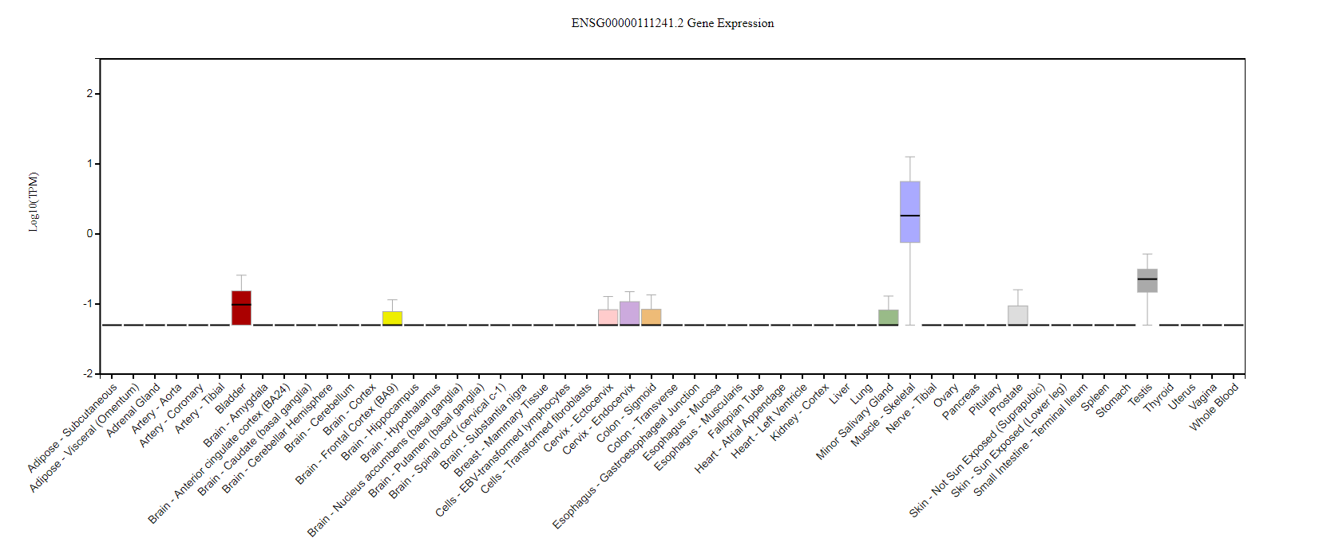

Slide 17
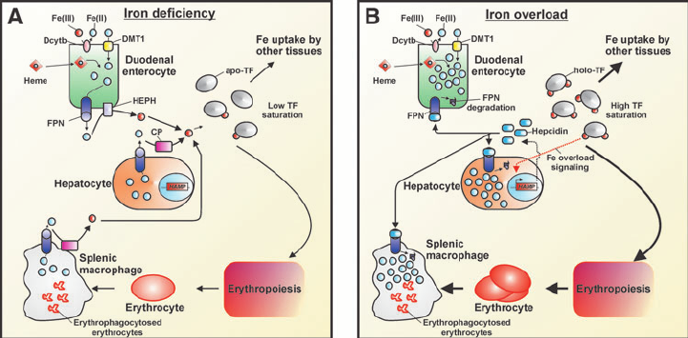

Slide 18
CHR | GENE | P | ORIG_SNP | NOHOM_SNP | X1 | X2 | X3 | X4
6 | HFE | 1.29E-08 | 14 | 10 | 8 | 10 | 189 | 6707
12 | FGF6 | 1.99E-06 | 10 | 6 | 6 | 12 | 153 | 6743
21 | KRTAP15-1 | 7.55E-05 | 5 | 2 | 11 | 7 | 1271 | 5625
20 | XKR7 | 0.000118 | 7 | 3 | 3 | 15 | 35 | 6861
20 | CABLES2 | 0.000128 | 7 | 5 | 3 | 15 | 36 | 6860
22 | THOC5 | 0.000138 | 9 | 6 | 13 | 5 | 1945 | 4951
18 | CABYR | 0.000254 | 17 | 10 | 5 | 13 | 229 | 6667
3 | CMSS1 | 0.000309 | 10 | 7 | 5 | 13 | 239 | 6657
5 | PCDHB2 | 0.000377 | 11 | 5 | 3 | 15 | 53 | 6843
9 | ZFP37 | 0.001067 | 16 | 7 | 9 | 9 | 1137 | 5759
3 | C3orf30 | 0.001156 | 28 | 12 | 13 | 5 | 2361 | 4535
12 | DENND5B | 0.001286 | 11 | 7 | 9 | 9 | 1166 | 5730
6 | MRS2 | 0.001299 | 10 | 8 | 4 | 14 | 188 | 6708
6 | BCLAF1 | 0.001686 | 29 | 20 | 4 | 14 | 202 | 6694
1 | NBPF3 | 0.001793 | 7 | 3 | 9 | 9 | 1220 | 5676
1 | BRDT | 0.002315 | 20 | 13 | 6 | 12 | 560 | 6336
17 | CAMKK1 | 0.002332 | 7 | 4 | 9 | 9 | 1265 | 5631
3 | CELSR3 | 0.002353 | 56 | 32 | 3 | 15 | 102 | 6794
12 | UHRF1BP1L | 0.002353 | 40 | 21 | 3 | 15 | 102 | 6794

Slide 19
FGF6 and FGF23: Biology Function in iron metabolism pathway
Another FGF genes
iron metabolism gene transcriptome network turbulence (regulator)
iron metabolism protein cell locating turbulence (Carrier)
FGF6
FGF23
PPP3CA
SIK3
LRRC16A
SLC17A3
SLC17A1
SLC40A1
LEAP1
TF
FPN
CDH10
HFE
TMPRSS6
TFR2
STON1
Hemoglobin (HBA1, HBA2, and HBB)
Ferritin (FTH1)
Lactoferrin (LT/LFT)
transferrin (TF)
Iron-binding proteins are carrier proteins and metalloproteins which play many important roles in metabolism. Iron is required by humans and bacteria for enzymes and metabolism to function properly. Iron-binding proteins bind iron tightly which make it unavailable for microbial use, limiting growth. Four iron-binding proteins are Hemoglobin, Ferritin, lactoferrin and transferrin. Hemoglobin is located in red blood cells. Transferrin is found in blood and tissue fluids. Lactoferrin is found in milk, blood, tears and saliva. Ferritin is found in every cell type.
https://string-db.org/
KEGG pathway(?)
Another interaction network method.

Slide 20
FGF6/FGF23 and Iron metabolism network
Step 1. Download all Liver RNA-seq data from TCGA with gdc-client
Do it in BIRCDEV13-LC (installed gdc-client)
Download confirmation file (LIHC and Kidney)
C:\Admin\gdc-client.exe
gdc-client.exe download -m gdc_manifest.2018-01-11T01_08_53.324183.txt -d
Step 2. collect all RNAseq data from rsem.genes.normalized_results
Notes:
gdc-client.exe download -m \\mcrfnas2\bigdata\Genetic\Projects\shg047\LIHC\gdc_manifest.2018-01-11T01_08_53.324183.txt -d \\mcrfnas2\bigdata\Genetic\Projects\shg047\LIHC\

Slide 21
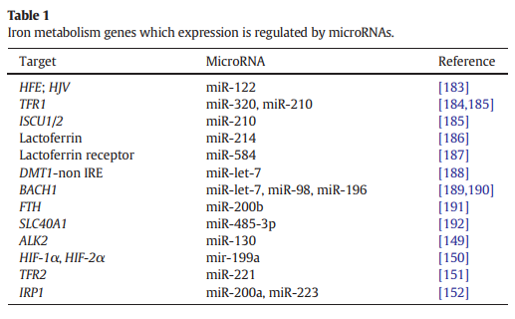
FGF6 and FGF23: Biology Function in iron metabolism pathway
and FGF23
hsa.miR.320a
hsa.miR.210.3p
hsa.miR.214.3p
hsa.miR.584.5p
hsa.miR.200b.3p
hsa.miR.485.3p
hsa.miR.221.3p
hsa.miR.200a.3p
hsa.miR.98.5p
hsa.miR.223.3p
hsa.miR.122.5p
(LTF)
Validate any miR-214-3p here target FGF6? We do it.
Validate any miR-122-5p here target FGF23? Yes. It is validated.
ComiR: Combinatorial miRNA target prediction tool

Slide 22
ENSEMBL_ID | GENE_ID | miR.320a | miR.210.3p | miR.214.3p | miR.584.5p | miR.200b.3p | miR.485.3p | miR.221.3p | miR.200a.3p | miR.98.5p | miR.223.3p | miR.122.5p
ENSG00000213066 | FGFR1OP | 1 | 0.8815 | 0.9996 | 0.826 | 0.93 | 1 | 1 | 1 | 0.9777 | 1 | 1
ENSG00000099810 | MTAP | 0.9617 | 0.8815 | 0.8725 | 0.962 | 0.93 | 0.8032 | 0.8491 | 0.8155 | 1 | 0.8565 | 0.984
ENSG00000124557 | BTN1A1 | 0.9912 | 0.8815 | 0.8725 | 0.826 | 0.767 | 0.8032 | 0.8491 | 0.8155 | 0.8519 | 0.8565 | 0.8757
ENSG00000171189 | GRIK1 | 0.8141 | 0.8815 | 0.8725 | 0.826 | 0.767 | 0.8032 | 0.8491 | 0.8155 | 0.8519 | 0.8565 | 0.8757
ENSG00000138675 | FGF5 | 0.8141 | 0.8815 | 0.8725 | 0.826 | 0.767 | 0.8032 | 0.9729 | 0.8155 | 0.9777 | 0.9762 | 0.984
ENSG00000186895 | FGF3 | 0.8141 | 0.8815 | 0.8725 | 0.826 | 0.767 | 0.8032 | 0.8491 | 0.8155 | 0.8519 | 0.8565 | 0.8757

Slide 23

Heparin: a potent inhibitor of hepcidin expression in vitro and in vivo (BLOOD, 20 JANUARY 2011 VOLUME 117, NUMBER 3 997 )

Slide 24
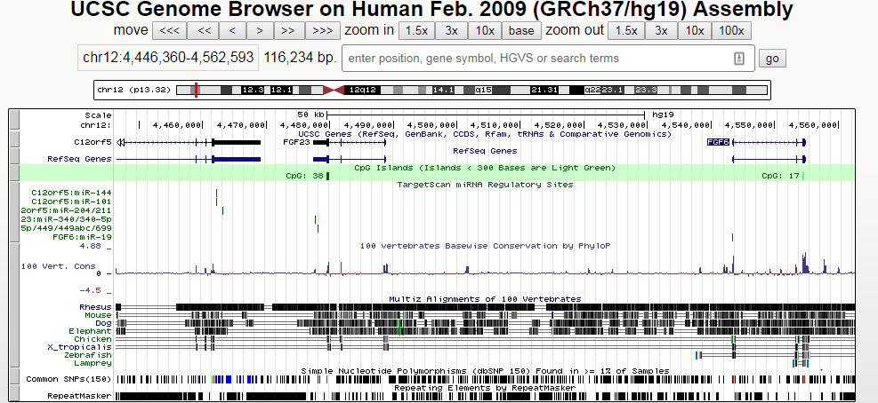
polycistronic miRNA cluster (miR-17,18,19 and 92)
Ferroportin (FPN) is the only known mammalian iron exporter. FPN expression is regulated at the transcriptional level by hypoxia-inducible factor-2alpha (HIF2α).
miR-19 promotes angiogenesis by directly targeting thrombospondin 1 (TSP-1) and connective tissue growth factor (CTGF)

Slide 25
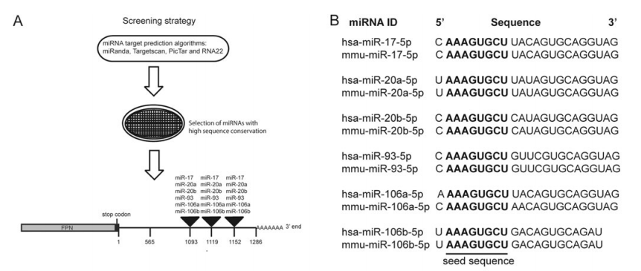

Slide 26
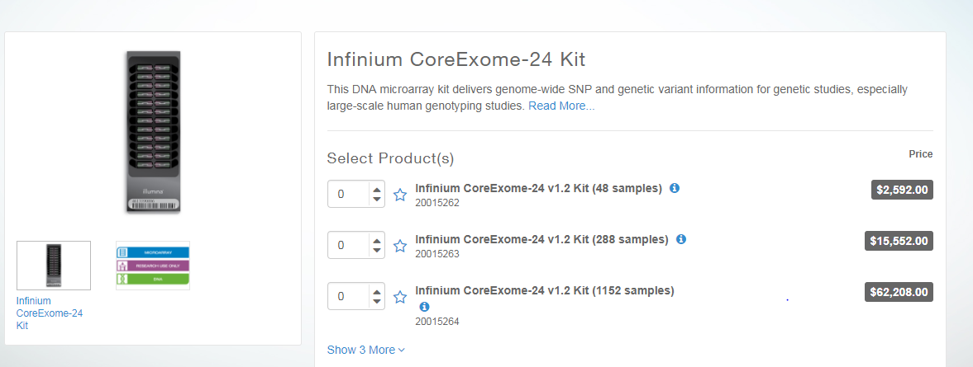
Find the annotation file and design the probes, including probe regions
Infinium CoreExome-24 v1.2 Support Files (hg19 human genome)
https://support.illumina.com/downloads/infinium-coreexome-24-v1-2-support-files.html

Slide 27
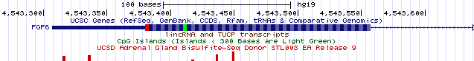
FGF6: Exon 1
>hg19_dna range=chr12:4543246-4543643 5'pad=0 3'pad=0 strand=+ repeatMasking=none
AAACAACTGAGGTCTCCCCAAGCACAGGATAAGCCTGATTCAGAAGCCAT GGAGGGCAAGGGGAATTCTTCGCTGGTGCAAAATTTCAATCGAACAGATG ATGCTTTAAATCTGTGAGCCTTCTTTTGTGGGTCCTTAGATCCTGGGAAG GAAATGAGTGACAGTCATGATCGGGGACACCTTGCTGCCCCGCTTTACCC GTCCGTATTTGCTCAGGGCAATGTAGGTCCCTTGGTACAAGTCTGACTCG TAGGCATTGTAATTGTTGGGCAGGAGGGTTTCTCTGAACTTGCATTCTTC TTGGAAGCTGGGCTGTGGAAGACATGGGCAAACAGCAGAGACTGGGTTAC AAATGAGGAGTGCTGCAGATGCCAGCTGGGCCGCAGAGAGTAGGCCCC
>hg19_dna range=chr12:4553194-4553510 5'pad=0 3'pad=0 strand=+ repeatMasking=none CCATTTAGATAGTCACTTCTCTACTCAGGACTTCATATTATTTTCTTCAA CTGTGTAAGCATCAAGCCTTGTAAACCTGGCACTTCCCCGGCCTGGTGAA CTCACCGTTGCGTACAATCTTCCTTTACTGTTCATGGCAACGAAGAGGGC ACTTCTCACTCCAAAGAGACTCACCACGCCTCGCTCCACAGTGGAAATTT CCAGCAGGCCTGACAAGGAAAGGGGGGCCACATTACCTAAGGCTTGTGCA AATCAGAGTGGGAACTTGAGCCGACAAGGGCATCTCAGTCCATCCCCCTT CTCCTAGAAAGCCAGAC
>hg19_dna range=chr12:4554200-4554846 5'pad=0 3'pad=0 strand=+ repeatMasking=none CACCAGGATGCTTGGACCGCAGTATATTGAGCTTGCACCCAGGCAGGGTC ACGTGGAATCATCTAAGTGGTGAGCAGCATTTCTGCCCCCTTTATCGTGC ATCCTGTCCGCTAGAGCAGGGCCCCTTCACCTTTTAGCCCTGCATGAGCC CAAACCCCCAAGCGTCCCGACTGGCTGCAGCTGGCACTCACTGTAGGGGT TCTCCTCGTGGGTCCCGCTGATCCGGCCGTCGGGGAGCACCTGGAGGTGA AAGCCGATGCCCACGTTGCAGTAGAGCCTCCGCTGCCGCTTGATCCCCAC CAAATAGCCACTTTCCCAGTTCACCCCGGCAATCTCTCCAGCTAGCCCGG CGCGAGACCTGGACAGCAGGGTGCCCCAGCCCCTCGAGTCCAGCAGCGTG TTGTTGGCACGGGTGCCTGCAGGCGAGGGCACCACCATGCCCACTAGGAT GCCTAGGAAGACGAGAGCCCACAGCGTGCCCTGCAGACGTCCTGCTCCCC GGGACATAGTGATGAACAGTTTCTGTCCCAGGGCCATCCACCTTGCCTCT CAGGCACGTGGTCAGAATTAATGGCCCTAAAAATACCGCCCTTCTTGTTT TTCTCCCTCCGGCATGGCGGCAGGGGCTTATTTTTGGAAGGCAGATG

Slide 28
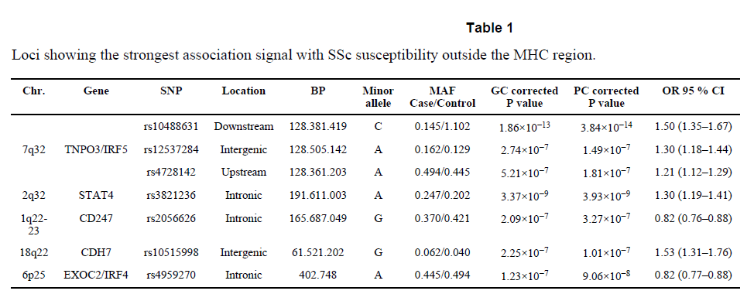
Nature genetics: first GWAS for SSc.
http://exac.broadinstitute.org/variant/4-186320906-C-G

Slide 29
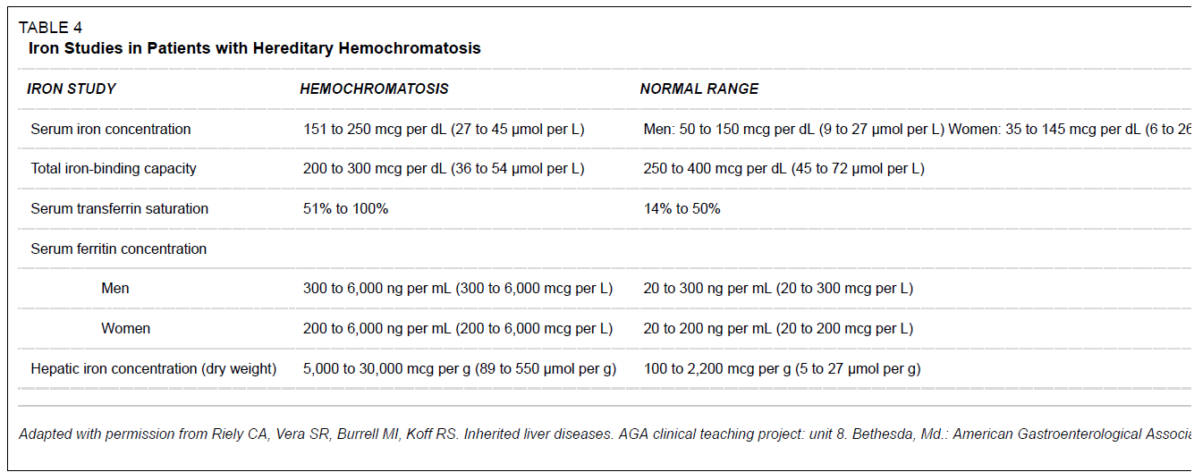
Inclusion criteria: Hemochromatosis
Serum transferrin saturation(STS) >45%
Serum ferritin levels >300 ng/mL in males and >200 ng/mL in females
Brandhagen, D.J., V.F. Fairbanks, and W. Baldus, Recognition and management of hereditary hemochromatosis. Am Fam Physician, 2002. 65(5): p. 853-60.

Slide 30
# Select all items from asian and european
grep rs7574865 ssc.gwas.txt
grep rs76285340 ssc.gwas.txt
grep rs146891517 ssc.gwas.txt
grep rs75287745 ssc.gwas.txt
grep rs45471499 ssc.gwas.txt
grep rs4317244 ssc.gwas.txt
grep rs114778719 ssc.gwas.txt
grep rs10488631 ssc.gwas.txt
grep rs12537284 ssc.gwas.txt
grep rs4728142 ssc.gwas.txt
grep rs3821236 ssc.gwas.txt
grep rs2056626 ssc.gwas.txt
grep rs10515998 ssc.gwas.txt
grep rs4959270 ssc.gwas.txt
#

Slide 31
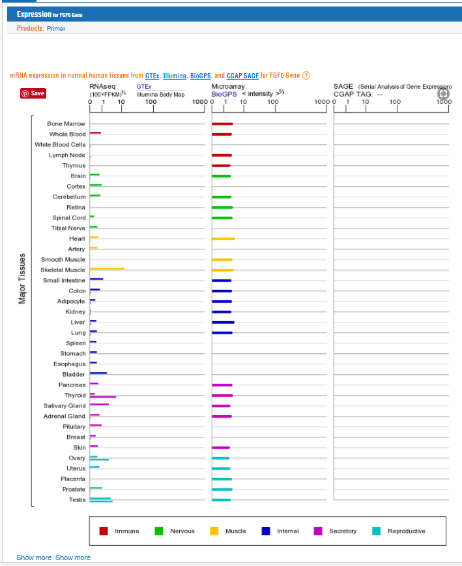
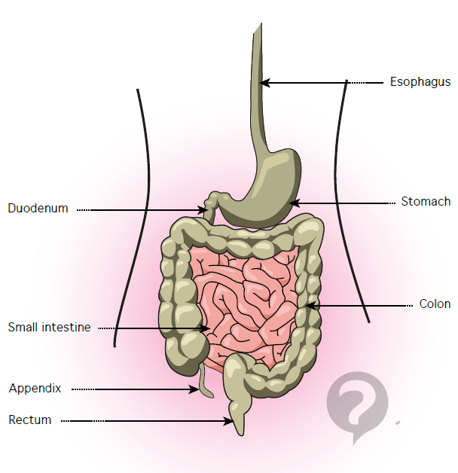
The portion of the small intestine called the duodenum is the chief area where iron absorption takes place. There may be a second minor absorption site near the end of the small intestinal tract. Once iron is absorbed it is carried (transported) by a protein called transferrin.

